Slide 1
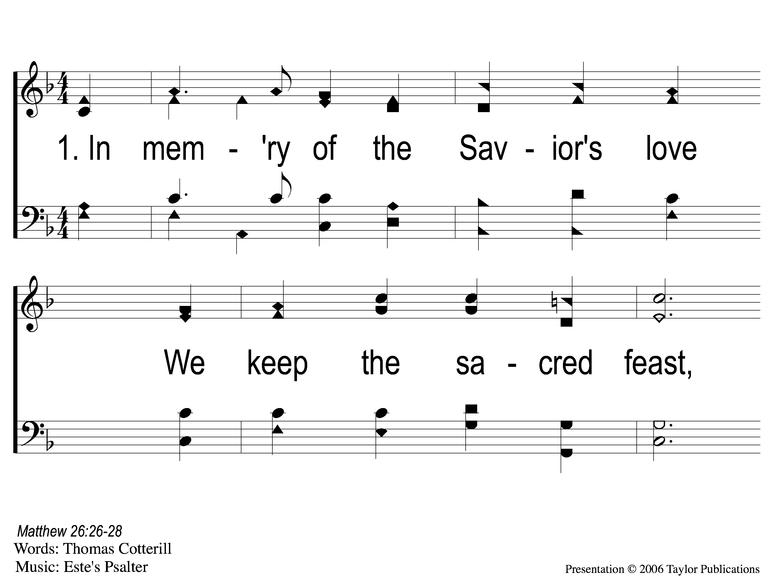
1-1 In Memory of the Savior’s Love
In Memory Of the Savior’s Love
137

Slide 2
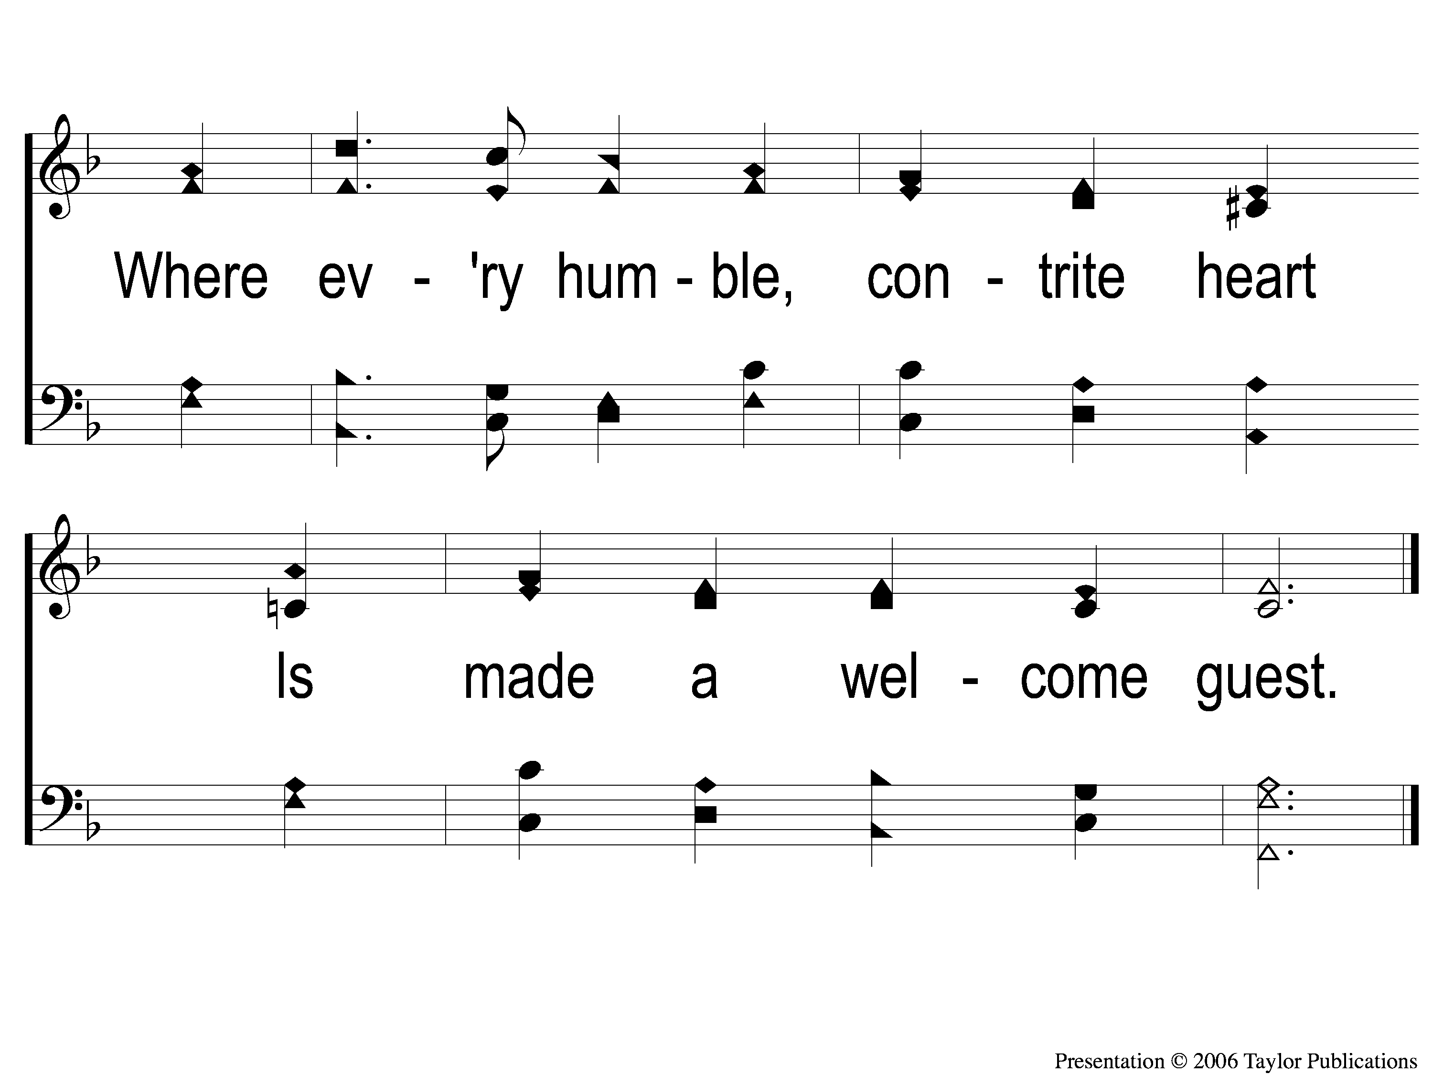
1-2 In Memory of the Savior’s Love
In Memory Of the Savior’s Love
137

Slide 3
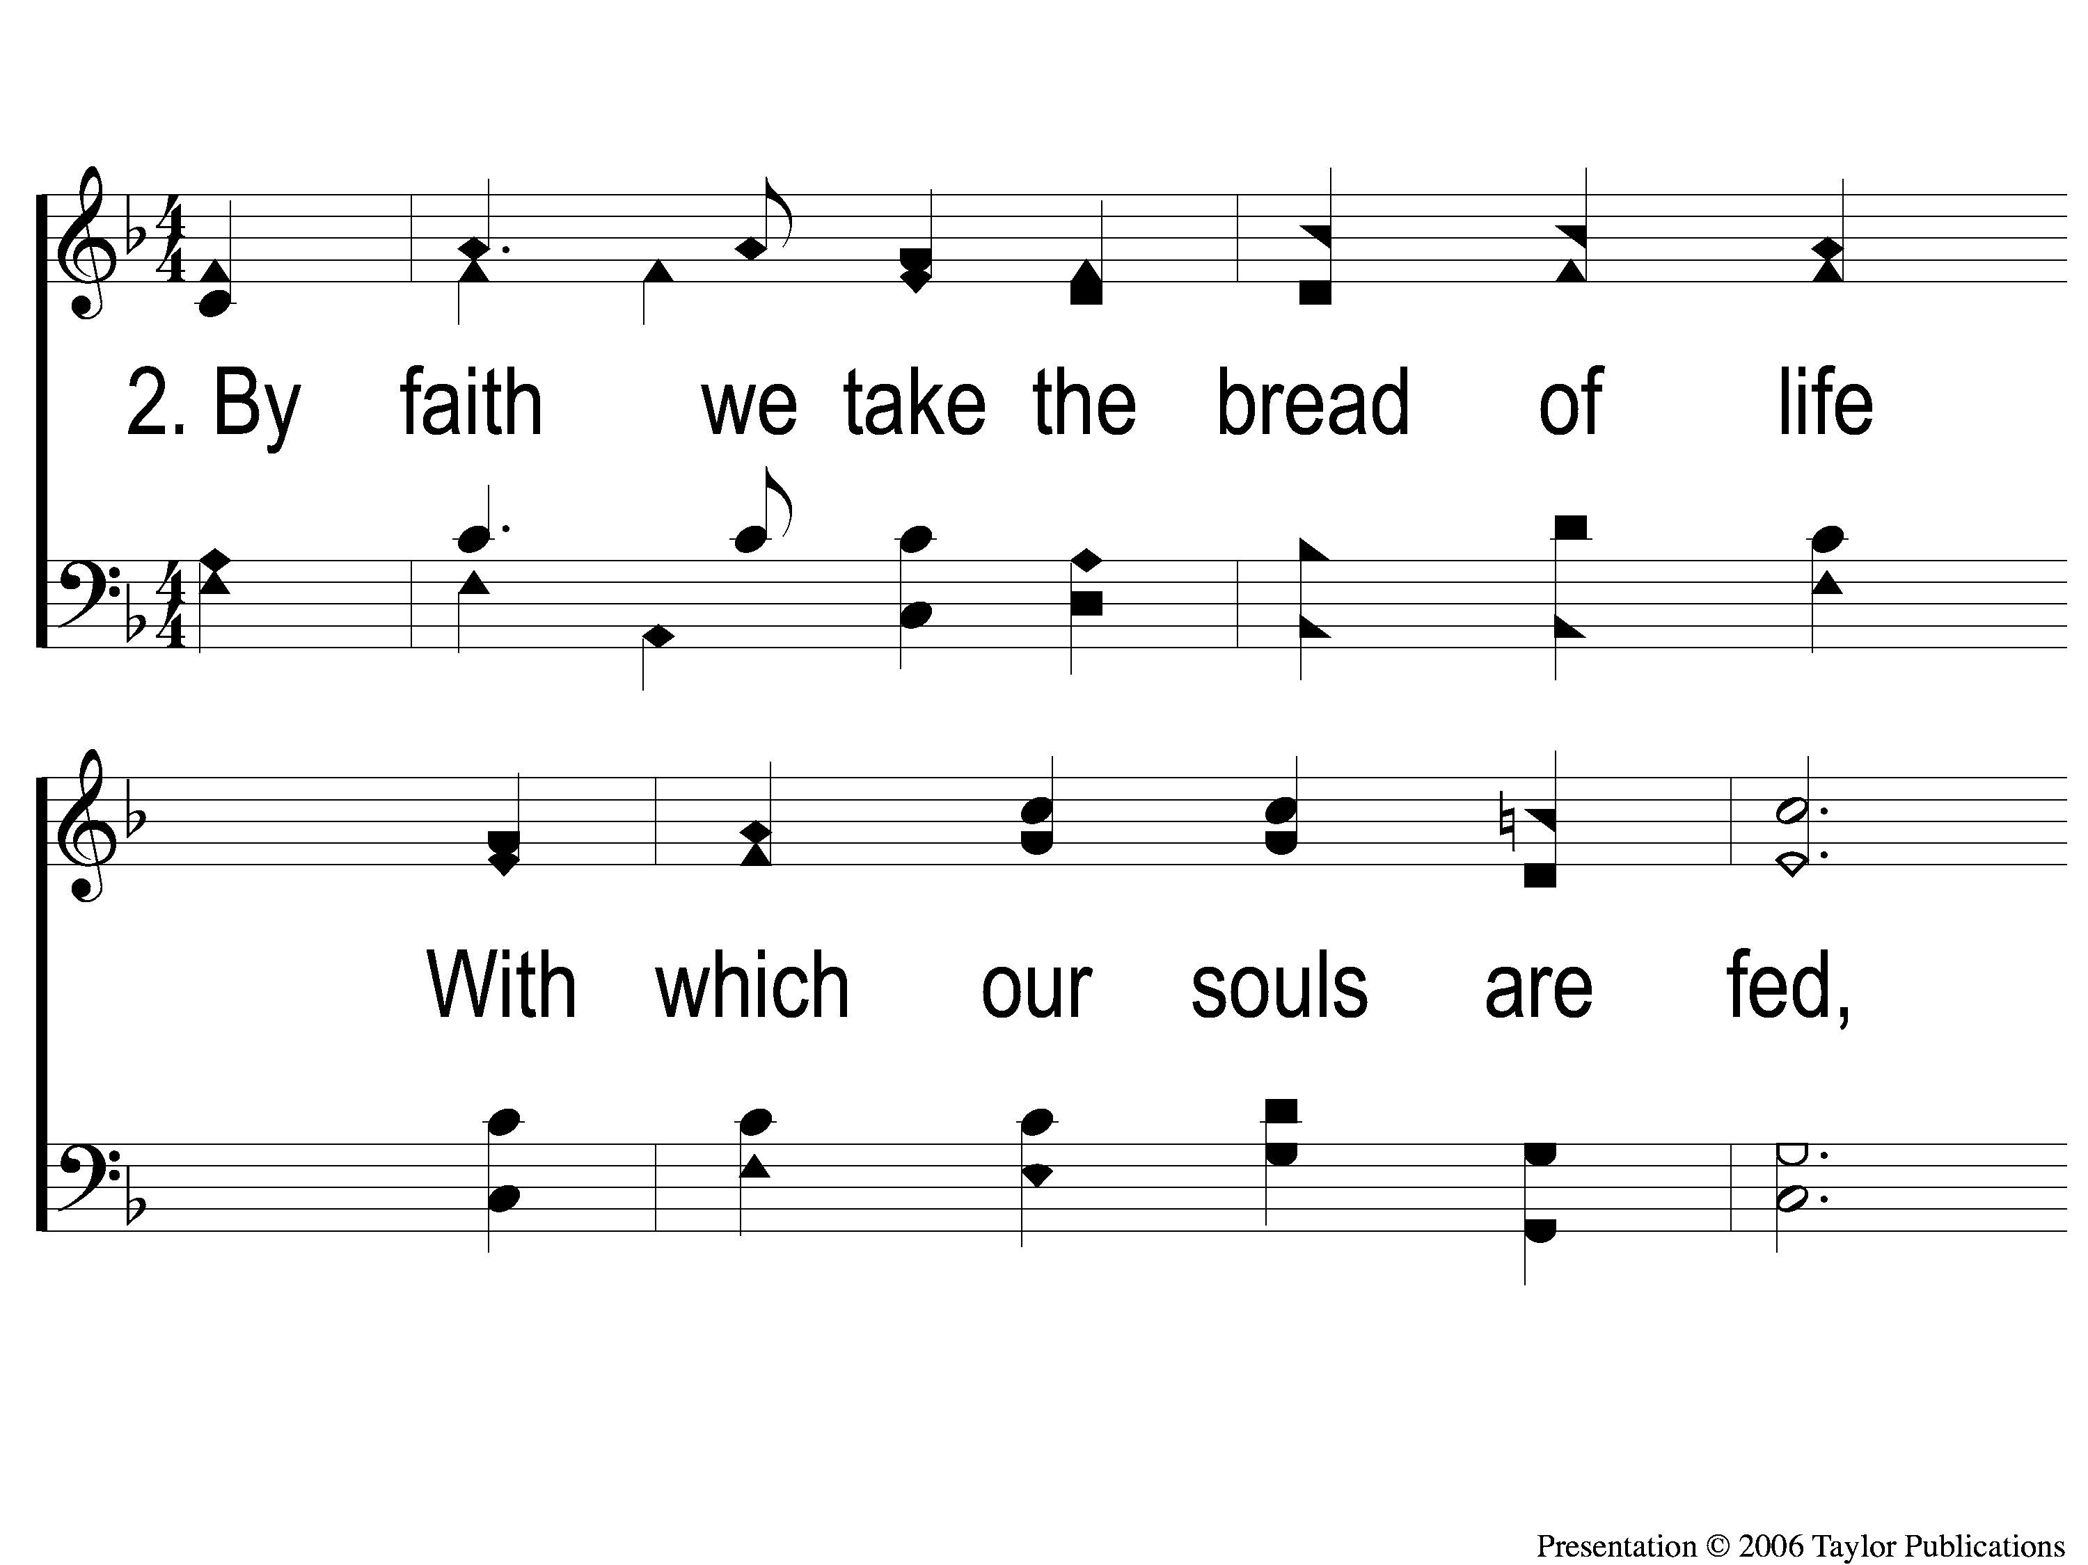
2-1 In Memory of the Savior’s Love
In Memory Of the Savior’s Love
137

Slide 4
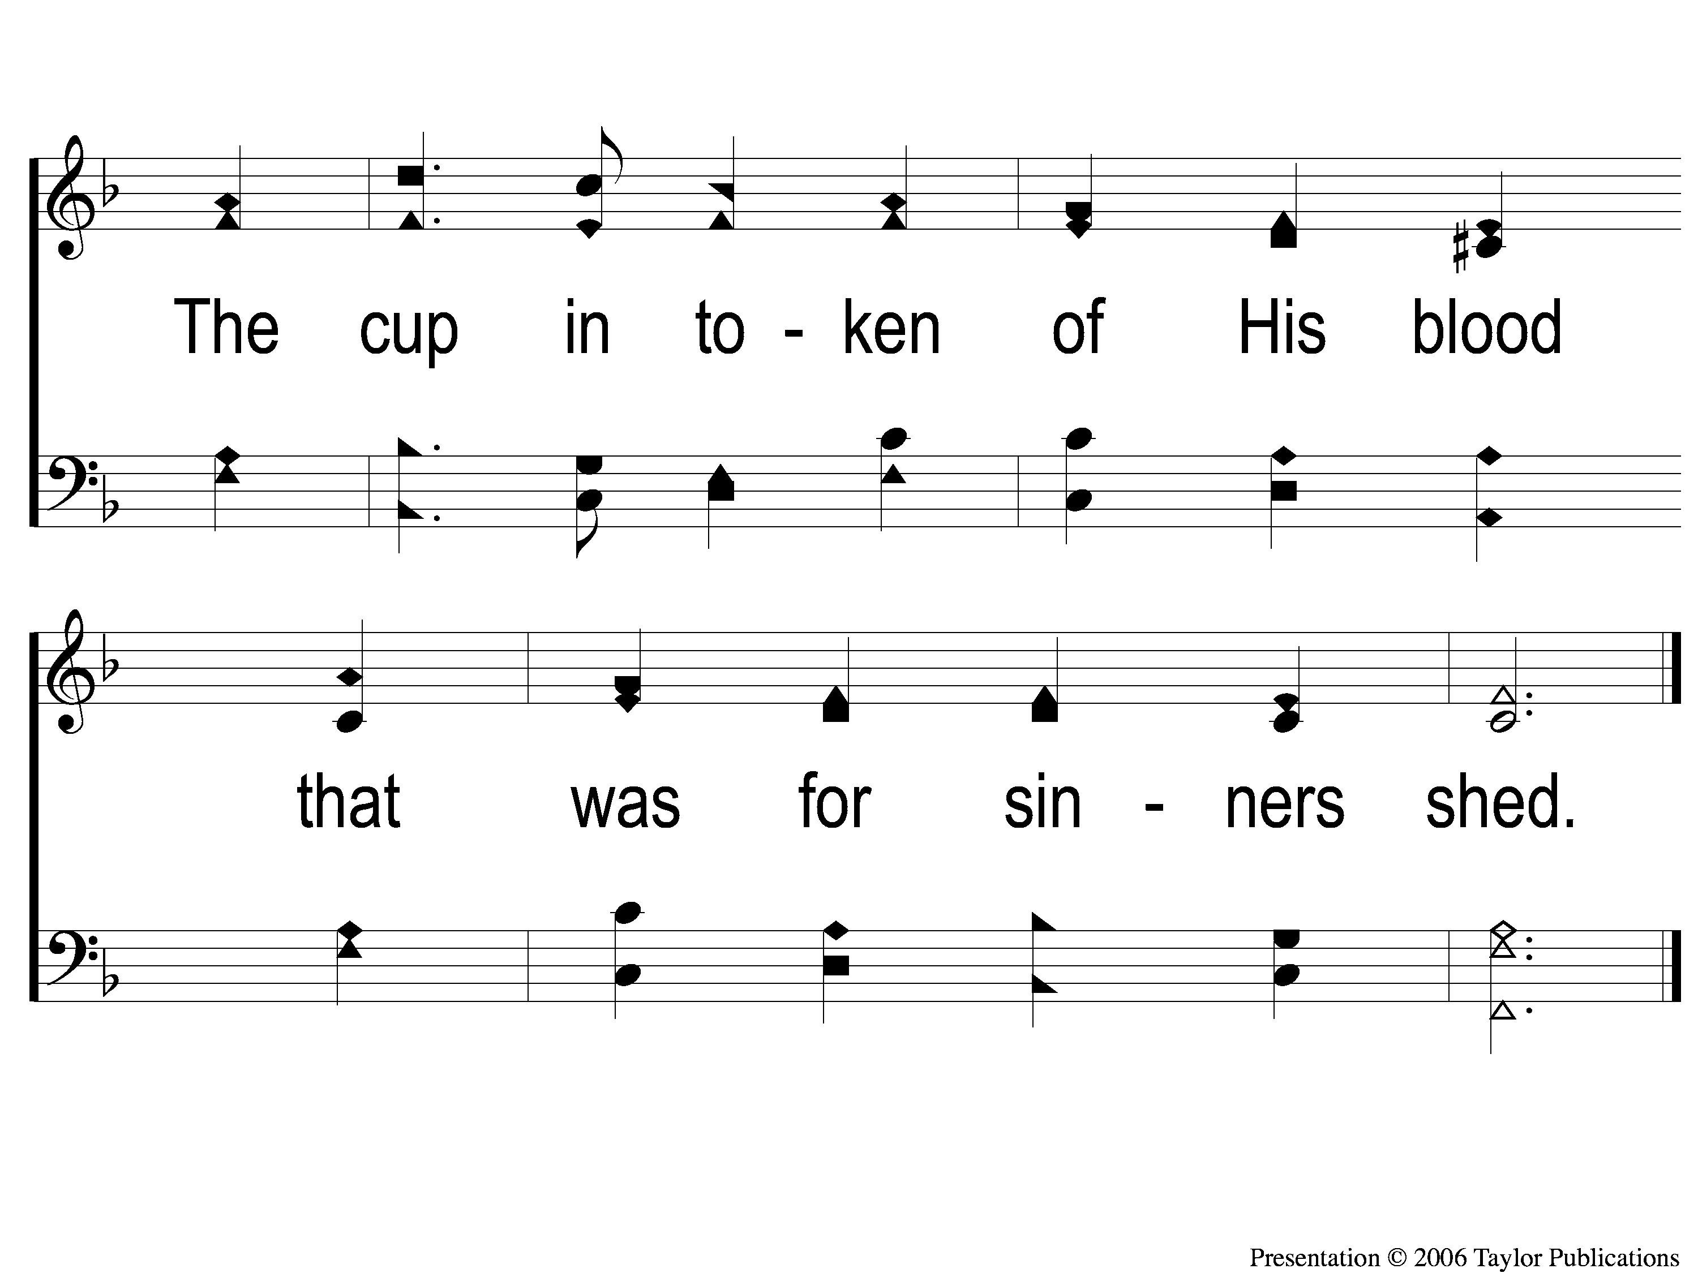
2-2 In Memory of the Savior’s Love
In Memory Of the Savior’s Love
137

Slide 5
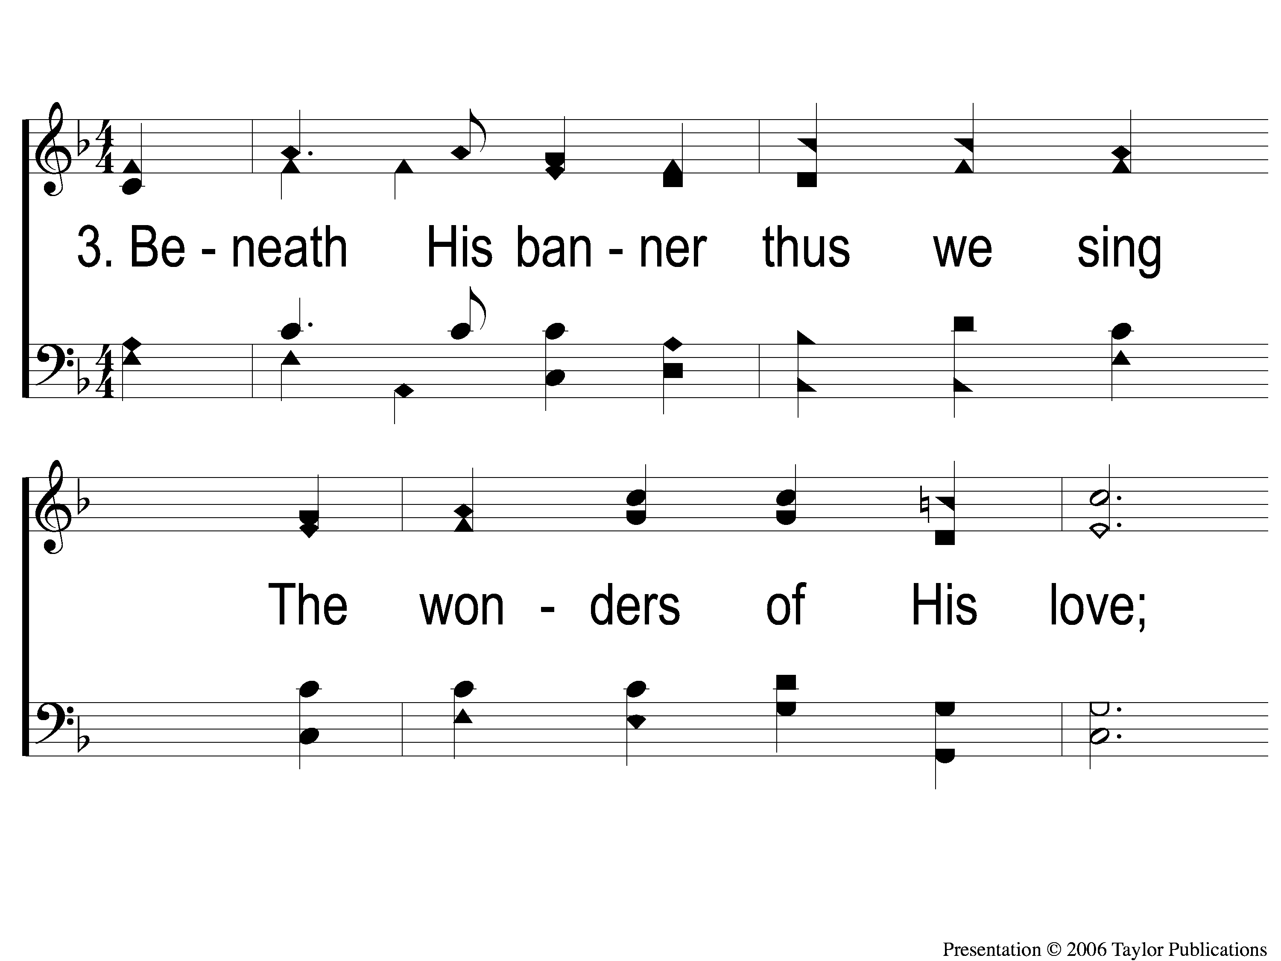
3-1 In Memory of the Savior’s Love
In Memory Of the Savior’s Love
137

Slide 6
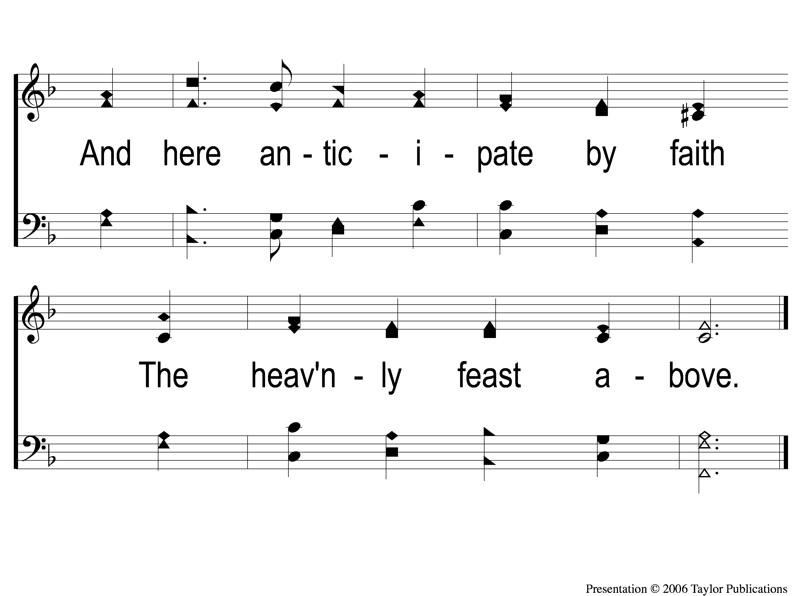
3-2 In Memory of the Savior’s Love
In Memory Of the Savior’s Love
137

